Slide 1
Quadratic Equations Unit Assessment
<Student Name>
April 2nd, 2020
Ms. deNeergaard’s 5th Period Algebra Class

Slide 2
Directions:
From the list posted in Schoology, complete each of the following slides.
Once you have completed each slide, save the PowerPoint under the following file name and submit into Schoology: <YourFirstName.YourLastName>QEAssessment – Example: Carrie.PorterQEAssessment
Delete this slide before saving your final file. That is worth 5 points!

Slide 3
Find the Axis of Symmetry and vertex for the following equations.
1.
$y=−x^{2}−4x+1$
2.
$$y=2x2+8$$
Show your work.
Search for “Ink Equation” to help.
Show your work.
You can use the Draw feature as well or you can complete your work on paper and take a picture.
Axis of Symmetry:
Vertex:
Axis of Symmetry:
Vertex:

Slide 4
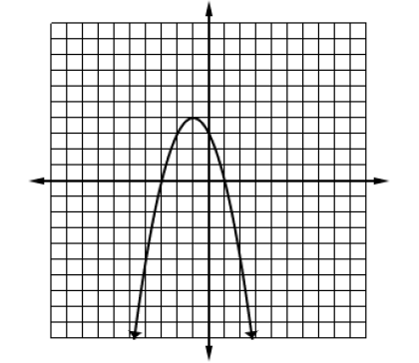
Complete each part using the given graph.
3.
Axis of Sym: x = | Vertex: (,)
Domain: | Range: y =
Zeros: x = {,}
Equation:
$y=x^{2}+2x+3$ $y=x^{2}−2x+3$ | C. $y=−x^{2}+2x+3$ D. $y={−x}^{2}−2x+3$

Slide 5
4.
The graph of the function $y=x^{2}$ is reflected across the x-axis, then translated two units left and six units down, write an equation to represent the new function.
5.
If the graph of the function $y=x^{2}$ is translated so its vertex is now at point (0,-3), which equation represents the new function?
$y={\left(x−3\right)}^{2}$
$y={\left(x+3\right)}^{2}$
$y=$ x² - 3
$y=$ x² + 3
Answer:
Answer:

Slide 6
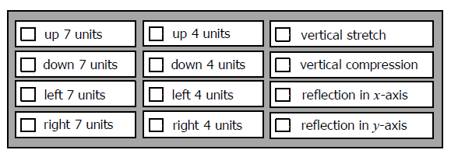
6.
Given the function, check all transformation that occurred from the graph of the function $y=x^{2}$.
7.
Write the equation below in standard form, factored form, then identify the zeros.
Standard Form:
Factored Form:
Zeros:
x = {,}

Slide 7
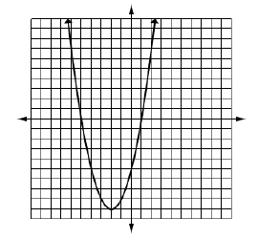
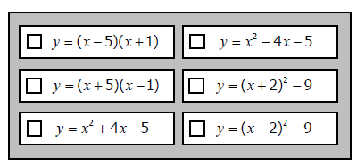
8.
Select the equation(s) that represent the parabola graphed below.

Slide 8
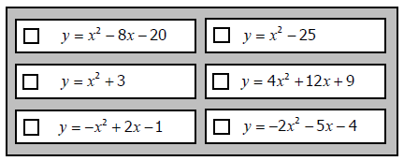
9.
Which quadratic equations have two solutions? Check all that apply.

Slide 9
Solve each equation. Simplify all irrational solutions.
10.
$$x2+10x=24$$
11.
$$4x2+5=6$$
Show your work.
You can use the Draw feature as well or you can complete your work on paper and take a picture.
Show your work.
You can use the Draw feature as well or you can complete your work on paper and take a picture.
x = {____, ____}
x = {____, ____}

Slide 10
Solve each equation. Simplify all irrational solutions.
12.
$$x2+18x=4x −49$$
13.
$$x2−6x−23=0$$
Show your work.
You can use the Draw feature as well or you can complete your work on paper and take a picture.
Show your work.
You can use the Draw feature as well or you can complete your work on paper and take a picture.
x = {____, ____}
x = {____, ____}

Slide 11
Solve each equation. Simplify all irrational solutions.
$$\frac{2}{3}x2+15=23$$
14.
$$x2−9x=0$$
15.
Show your work.
You can use the Draw feature as well or you can complete your work on paper and take a picture.
Show your work.
You can use the Draw feature as well or you can complete your work on paper and take a picture.
x = {____, ____}
x = {____, ____}

Slide 12
Solve each equation. Simplify all irrational solutions.
16.
$$5x2+14x=x+6$$
17.
$2x2 − 10x+11=$ 0
Show your work.
You can use the Draw feature as well or you can complete your work on paper and take a picture.
Show your work.
You can use the Draw feature as well or you can complete your work on paper and take a picture.
x = {____, ____}
x = {____, ____}

Slide 13
Solve each equation. Simplify all irrational solutions.
18.
$$4x2−24=20x$$
19.
$−x2+8=$ x – 3
Show your work.
You can use the Draw feature as well or you can complete your work on paper and take a picture.
Show your work.
You can use the Draw feature as well or you can complete your work on paper and take a picture.
x = {____, ____}
x = {____, ____}

Slide 14
Solve each equation. Simplify all irrational solutions.
20.
$$2x2+8x+10=3$$
Factoring | Completing the Square | The Quadratic Formula
x = {____, ____}
x = {____, ____}
x = {____, ____}

